Slide 1
Designed and Manufactured in Kentucky

Slide 2
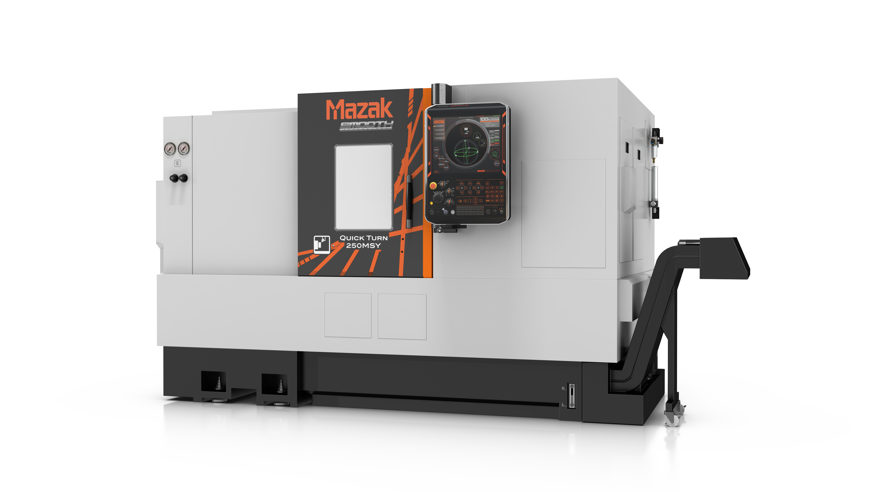
Specification
Item |  | QUICK TURN 250MSY
Travel | X / Y / Z-axis | 9”/4”/22.625” (230/100/575 mm)
 | W-axis | 23” (585mm)
 | C-axis | 360 °
1st Spindle |  | A2-8” / 35 HP / 4000 rpm/ 186 ft-lbs (Opt) A2-8” / 35 HP / 4000 rpm / 368 ft-lbs
2nd Spindle |  | A2-5” 15 HP / 6,000 rpm / 66 ft-lbs
Turret / Mill Spindle |  | 12 Position 10 HP / 6 ,000 rpm / 81 ft-lbs Direct Drive w/ Built In Motor
Max. Turning Length / Diameter |  | 22.70” / Ø13.5” (541 mm / Ø348 mm)

Slide 3
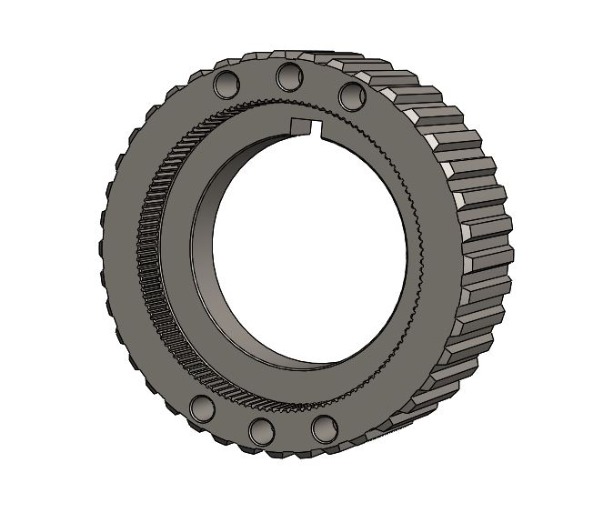
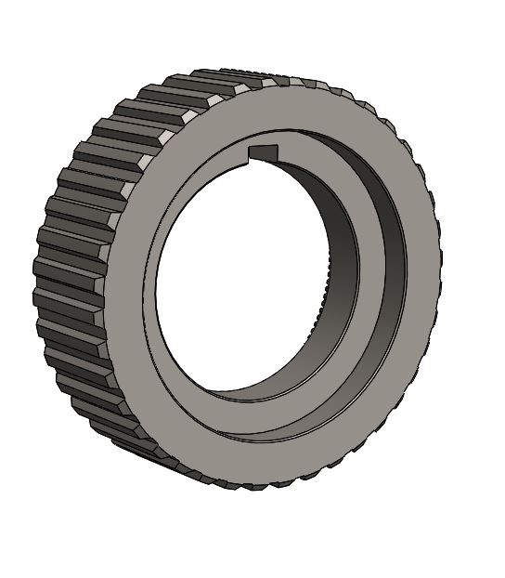
Technology
General Machinery (Steel)
Gear Machining with Hobbing option & ID Broaching.
1
I/D Broaching and keyway cutting using
the driven milling unit.
2
Mazak Hobbing Option
4
Drilled and chamfered holes.
3
ID & OD Turning
Benefits
1
New design Bolt-on turret
New rigid Bolt-on turret utilized to perform both the key and spline.
Hobbing
The Hobbing Option syncs the milling unit with the C axis to provide single set up Gear Manufacturing.
Heavy duty cutting
Rigid I/D and O/D turning providing heavy depths of cuts for
improved productivity.
Milling
Milling capability reduces set up time, improves part quality and minimizes secondary operations.
2
3
4

Slide 4
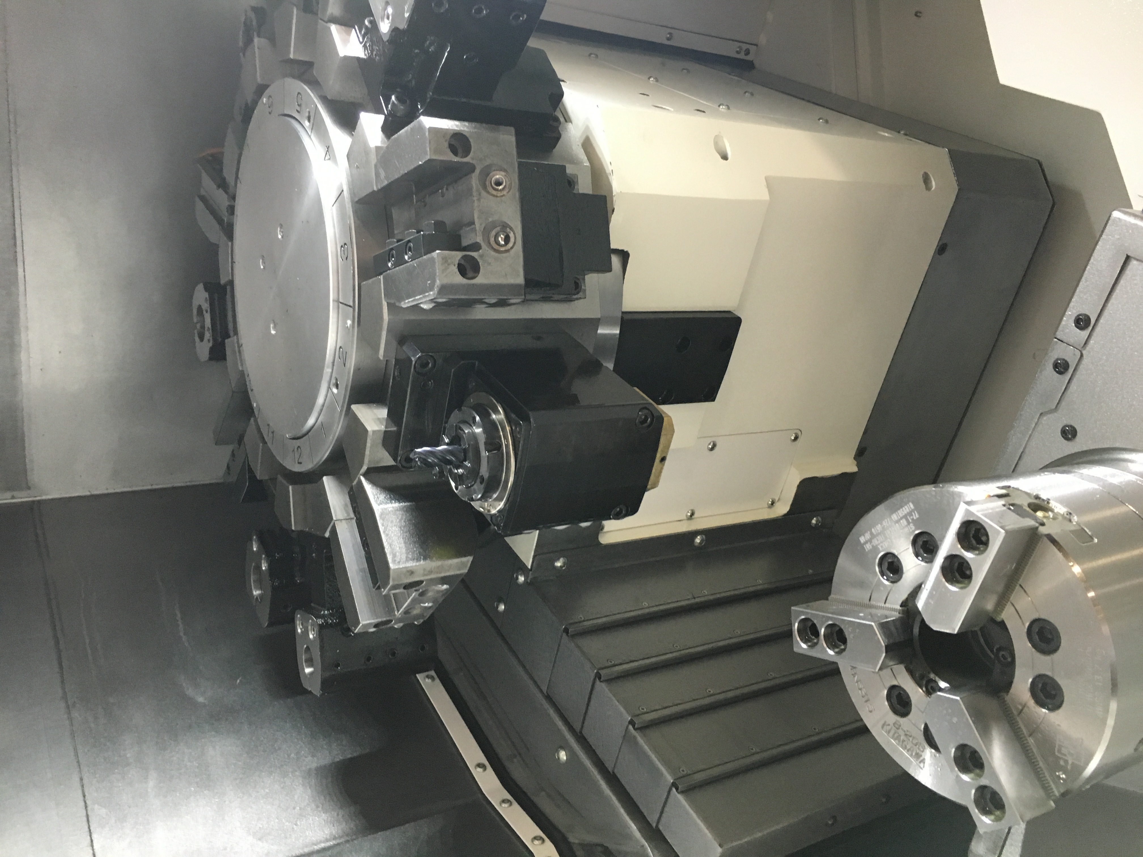
Technical Feature
NEW HIGH PERFORMANCE
MILLING CAPABILITY
1
Increased mill spindle rpm and torque specifications expands the variety of applications available. When used with optional 1:2 tooling package, 10,000 rpm is possible.
2
New direct drive mill function combines a proven driven tool design and a new built-in, liquid cooled mill motor.
3
Availability of either a VDI or Bolt-On turret allows users to utilize existing tooling and save on tooling costs.
4
The optional high torque main spindle provides an economical option for increased spindle torque requirements.

